Slide 1
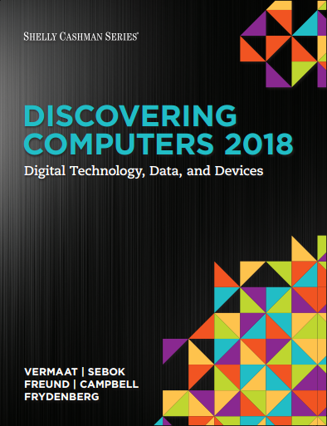

DISCOVERING COMPUTERS 2018 Digital Technology, Data, and Devices
Module 7
Input and Output: Extending Capabilities of Computers and Mobile Devices
© 2018 Cengage版權所有，為課本著作之延伸教材，亦受著作權法之規範保護，僅作為授課教學使用，禁止列印、影印、未經授權重製和公開散佈

Slide 2
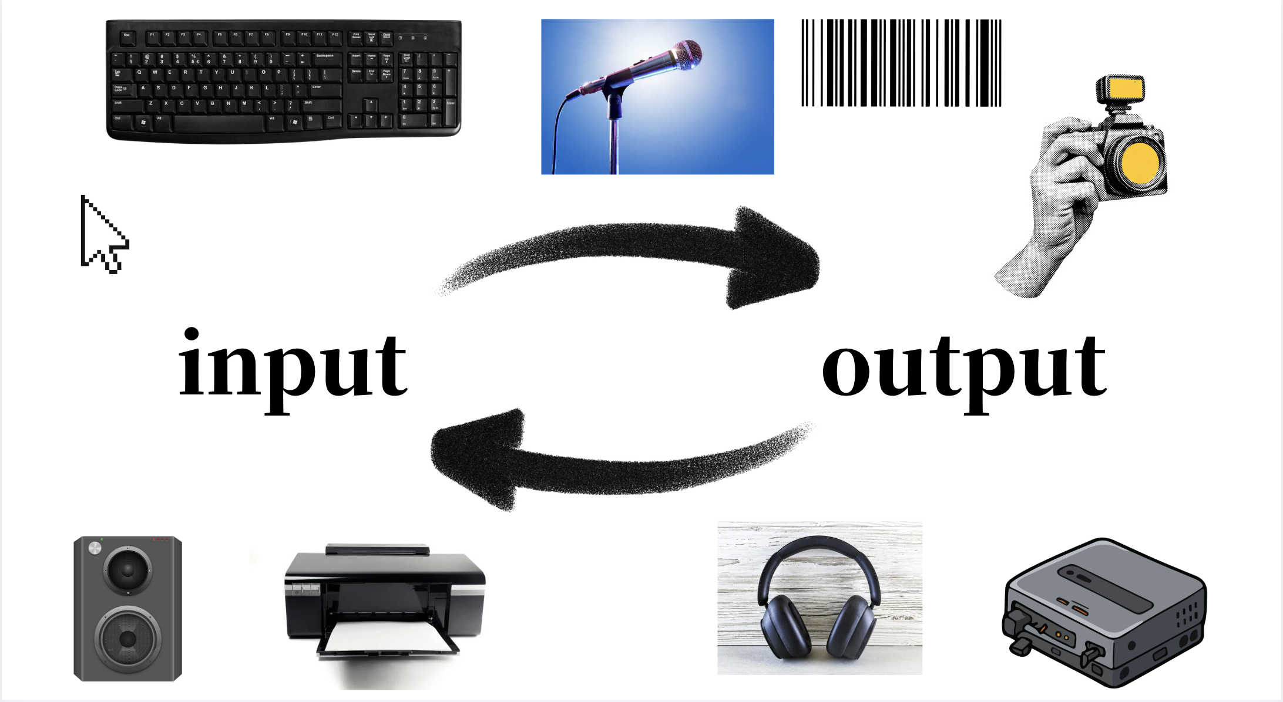
DISCOVERING COMPUTERS 2018 Digital Technology, Data, and Devices
© 2018 Cengage版權所有，為課本著作之延伸教材，亦受著作權法之規範保護，僅作為授課教學使用，禁止列印、影印、未經授權重製和公開散佈

Slide 3
Objectives Overview (1 of 2)
Differentiate among various types of keyboards: standard, compact, on-screen, virtual, ergonomic, gaming, and wireless.
Describe characteristics of various pointing devices: mouse, touchpad, and trackball.
Describe various uses of touch screens.
Describe various types of pen input: stylus, digital pen, and graphics tablet.
Describe various uses of motion input, voice input, and video input.

Slide 4
Objectives Overview (2 of 2)
Differentiate among various scanners and reading devices.
Explain the characteristics of various displays.
Summarize the various types of printers.
Identify the purpose and features of speakers, headphones and earbuds, data projectors, interactive whiteboards, and force-feedback game controllers and tactile output.
Identify various assistive technology input and output methods.

Slide 5
知識重點
滑鼠的種類
stylus vs. digital pen
Optical Character Recognition (OCR) Optical Mark Recognition (OMR)
FRID(Radio Frequency IDentification)
印表機運作原理
DVI、HDMI、displayPort 比較

Slide 6
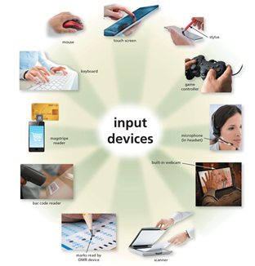
Input is any data and instructions entered into the memory of a computer
Figure 7-1 Users can enter data and instructions into computers and mobile devices in a variety of ways.

Slide 7
What Is Input? (2 of 2)
Commonly used input methods include:
Keyboard
Pointing devices
Touch screens
Pen input
Motion input
Voice input
Video input
Scanners and reading devices

Slide 8
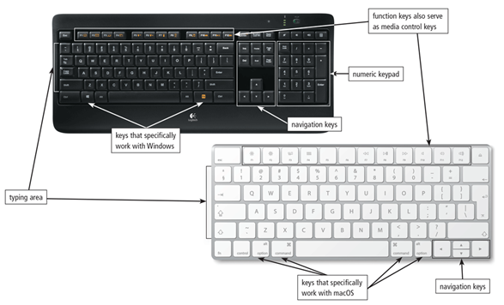
A keyboard is an input device that contains keys you press to enter data and instructions into a computer or mobile device.
Figure 7-2 On a standard keyboard, you type using keys in the typing area and on the numeric keypad. Some of the keys on standard keyboards differ, depending on the operating system with which they are designed to work.

Slide 9
Keyboards (2 of 4)
Nearly all keyboards have…
Typing area
Function keys （如F5 重新整理，F11切換全螢幕模式）
Toggle key （如Caps Lock）
Navigation keys （如方向鍵）
Media control buttons （音量鍵）
Internet control buttons
Other special keys （esc）

Slide 10
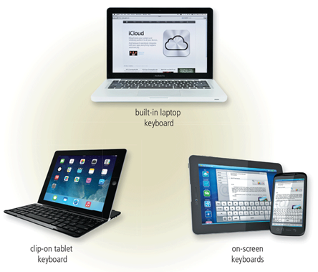
There are a variety of keyboard options for mobile computers and devices
Figure 7-3 Users have a variety of keyboard options for mobile computers and devices.

Slide 11
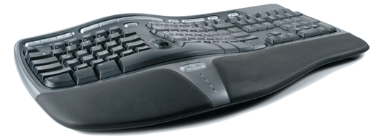
An ergonomic keyboard has a design that reduces the chance of Repetitive Strain Injuries (RSIs) of wrist and hand.
Ergonomics incorporates comfort, efficiency, and safety in the design of the workplace.
Figure 7-4 An ergonomic keyboard.

Slide 12
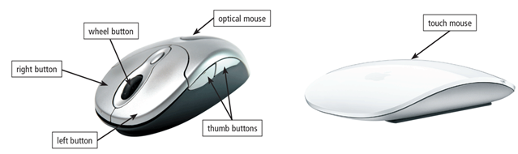
A pointer is a small symbol on the screen whose location and shape change as a user moves a pointing device.
A mouse is a pointing device that fits under the palm of your hand comfortably:
Optical mouse, laser mouse, and touch mouse
Figure 7-5 An optical mouse has buttons. A touch mouse often has no buttons

Slide 13
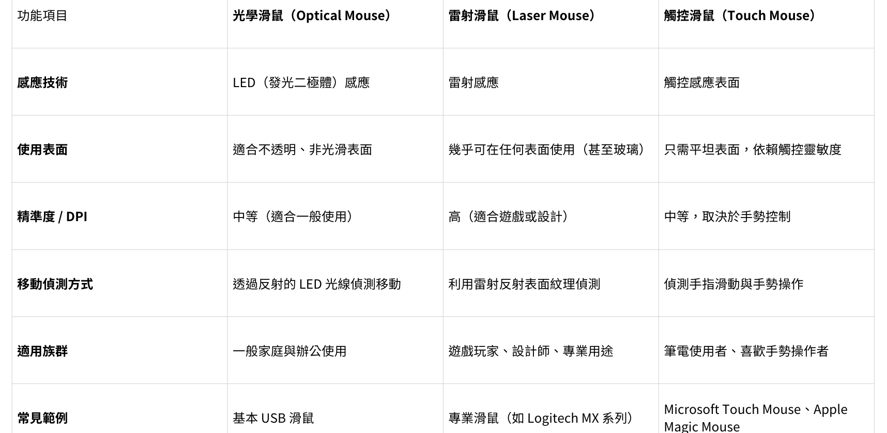

Slide 14
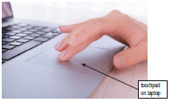
Pointing Devices (2 of 3)
Touchpad
A touchpad is a small, flat, rectangular pointing device that is sensitive to pressure and motion

Slide 15
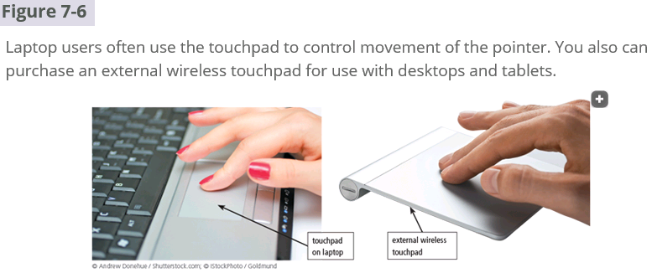

Slide 16
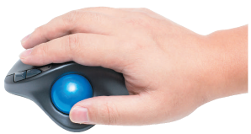
Pointing Devices (3 of 3)
Trackball
A trackball is a stationary pointing device with a ball on its top or side

Slide 17
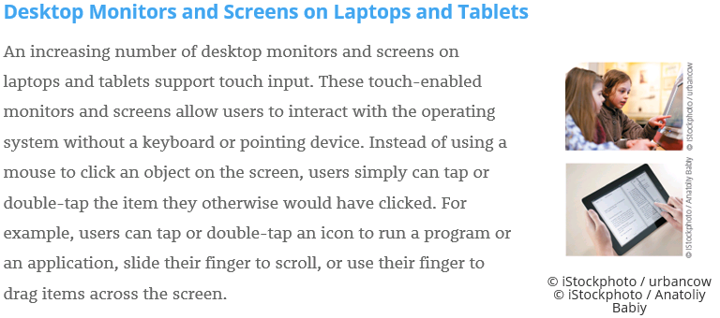

Slide 18
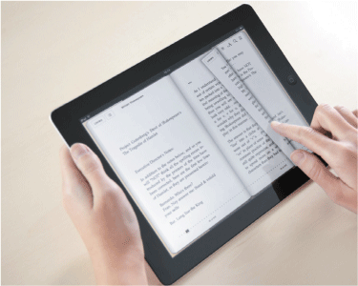
Touch Screens
A touch screen is a touch-sensitive display
Pages 324 - 325

Slide 19
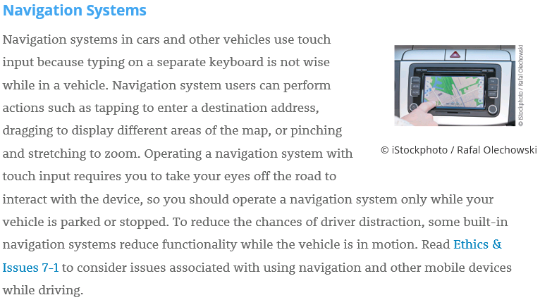

Slide 20
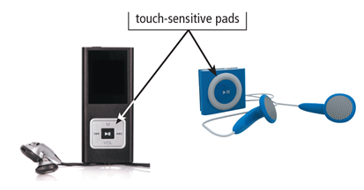
A touch screen is a touch-sensitive display
Figure 7-8 You use your thumb or finger to rotate or press buttons on a touch-sensitive pad, which commonly is found on portable media players.

Slide 21
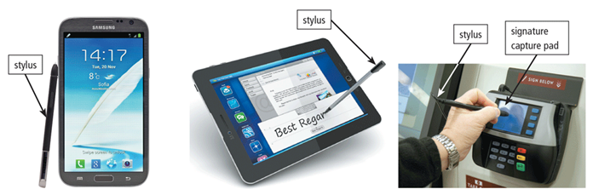
With pen input, you touch a stylus or digital pen on a flat surface to write, draw, or make selections.
Figure 7-9 You use a stylus to write, draw, or make selections on a touch screen that supports pen input.

Slide 22
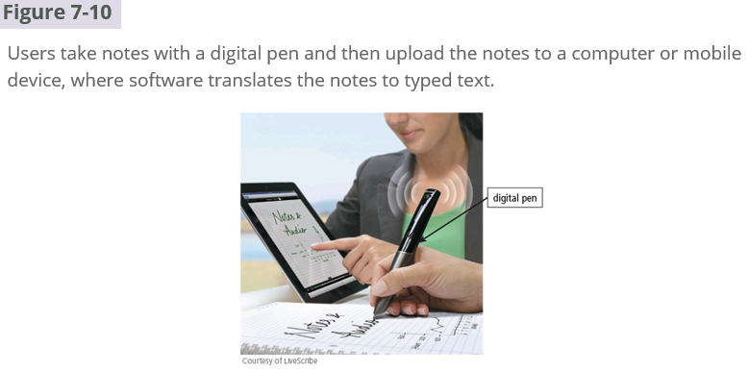

Slide 23
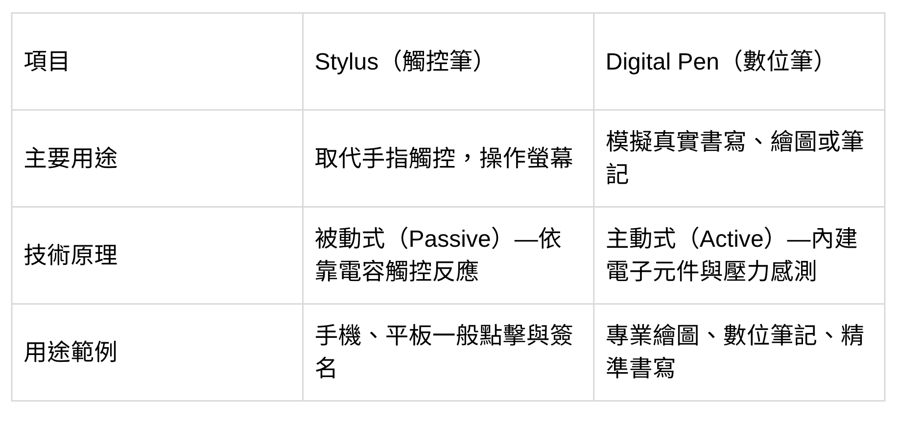
Stylus vs. Digital Pen

Slide 24
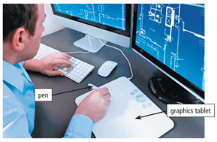
A graphics tablet, also called a digitizer, is an electronic plastic board that detects and converts movements of a style or digital pen into signals that are sent to the computer.
Figure 7-11 Architects use a graphics tablet to create blueprints.

Slide 25
哈哈哈
https://www.youtube.com/shorts/T_IQh0UNym8?feature=share
https://www.youtube.com/watch?v=pdRauHl0Op4

Slide 26

哈哈哈
https://www.youtube.com/shorts/T_IQh0UNym8?feature=share
https://www.youtube.com/watch?v=pdRauHl0Op4

Slide 27
哈哈哈
https://www.youtube.com/shorts/T_IQh0UNym8?feature=share
https://www.youtube.com/watch?v=pdRauHl0Op4

Slide 28
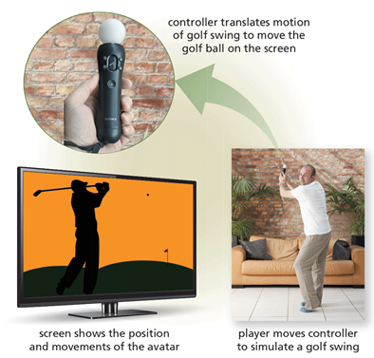
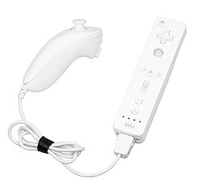
With motion input, sometimes called gesture recognition, users can guide on-screen elements using air gestures

Slide 29

Motion, Voice, and Video Input (2 of 8)
Voice input is the process of entering input by speaking into a microphone.
Voice recognition, also called speech recognition, is the computer or mobile device’s capability of distinguishing spoken words.

Slide 30
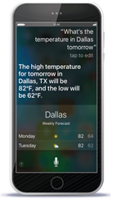
SIRI: Speech Interpretation and Recognition Interface
Figure 7-12 With SIRI, you can speak instructions and commands to the smartphone and its apps. As shown here, the user asks Siri about the weather, to which SIRI replies by speaking a message and displaying the forecast.

Slide 31
Motion, Voice, and Video Input (4 of 8)
Audio input is the process of entering any sound into the computer such as speech, music, and sound effects.
Music production software allows users to record, compose, mix, and edit music and sounds.

Slide 32
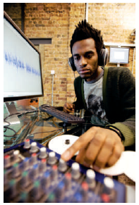
Figure 7-13 This sound engineer uses a computer to mix music.

Slide 33
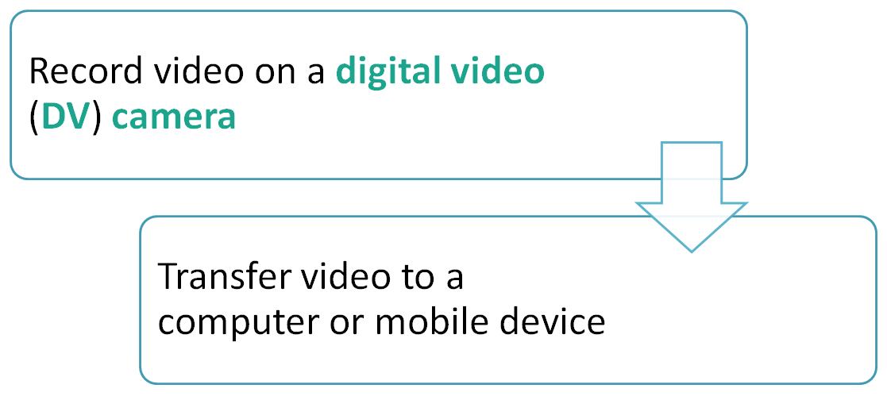
Motion, Voice, and Video Input (6 of 8)
Video input is the process of capturing full-motion images and storing them on a computer or mobile device’s storage medium

Slide 34
Motion, Voice, and Video Input (7 of 8)
A webcam is a type of Digital Video (DV) camera that enables a user to:
Capture video and still images.
Send email messages with video attachments.
Broadcast live images or video over the Internet.
Conduct videoconferences.
Make video calls.

Slide 35
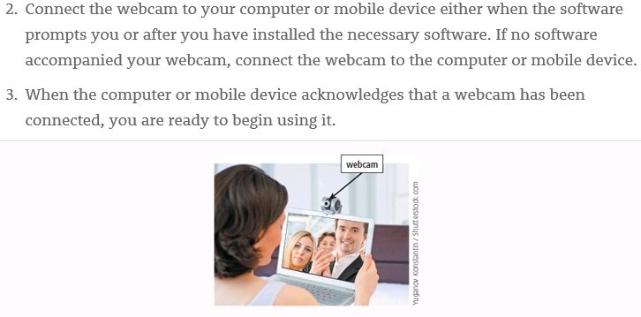

Slide 36
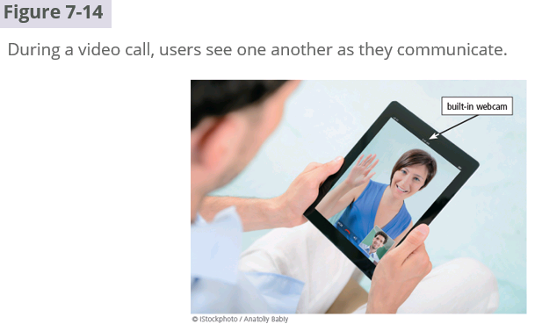

Slide 37
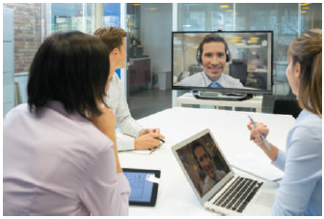
A videoconference is a meeting between two or more geographically separated people
Figure 7-14 To save on travel expenses, many large businesses use videoconferencing.

Slide 38
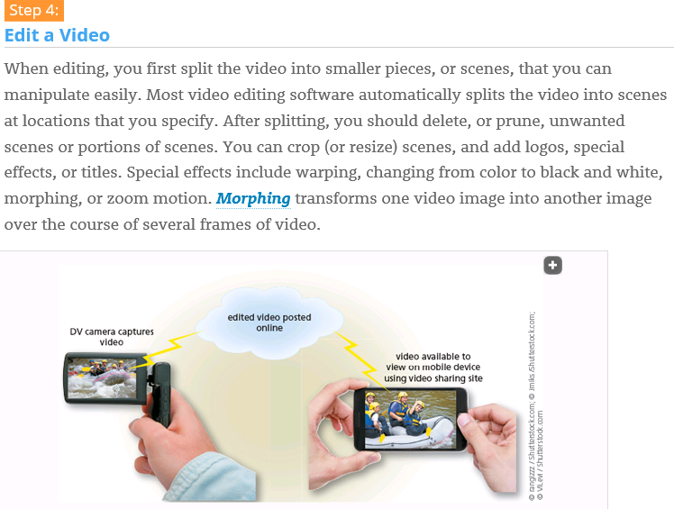

Slide 39
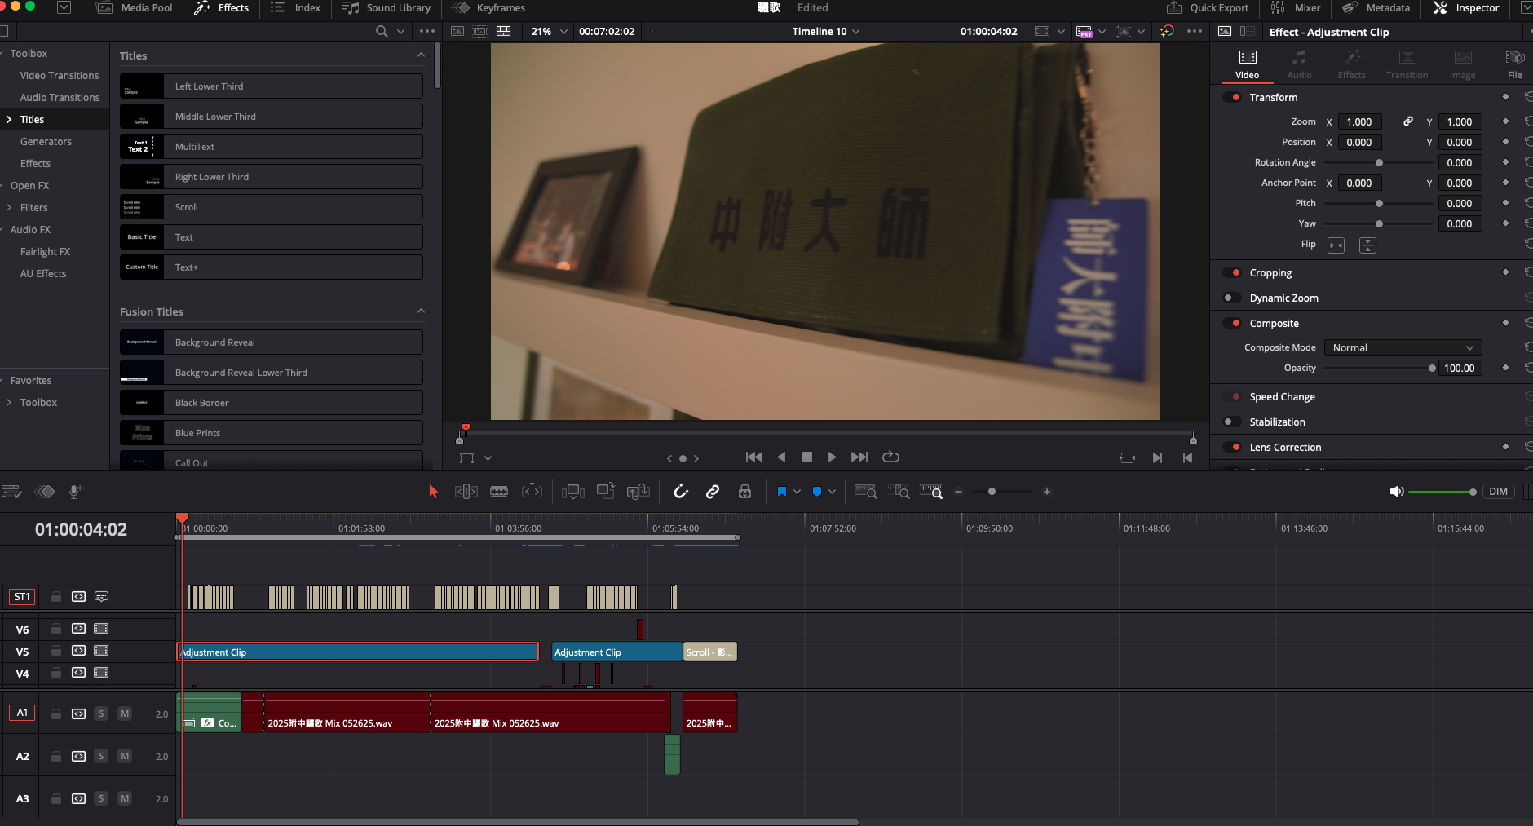

Slide 40
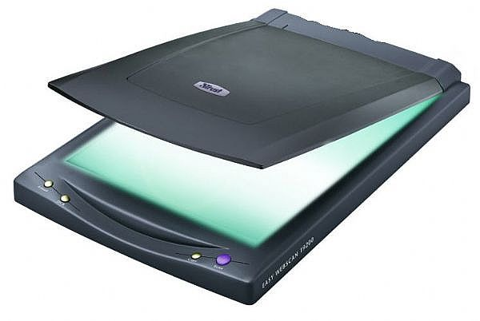
Scanners and Reading Devices (1 of 10)
A scanner is a light-sensing input device that reads printed text and graphics and then translates the results into a form the computer can process
A flatbed scanner works in a manner similar to a copy machine except it creates a file of the document in memory instead of a paper copy

Slide 41
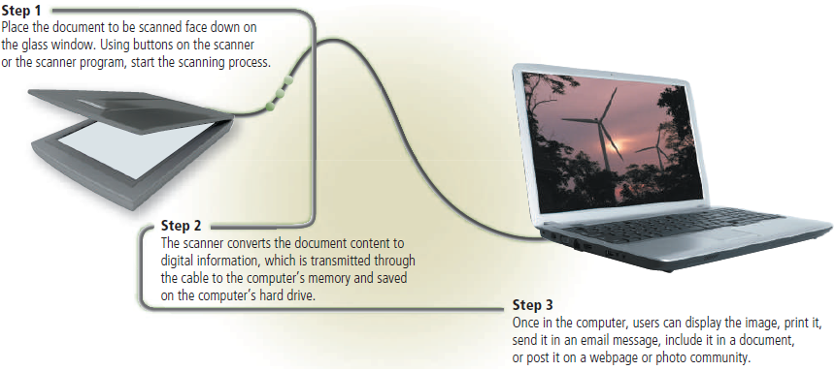
Figure 7-16 This figure shows how a flatbed scanner works.

Slide 42
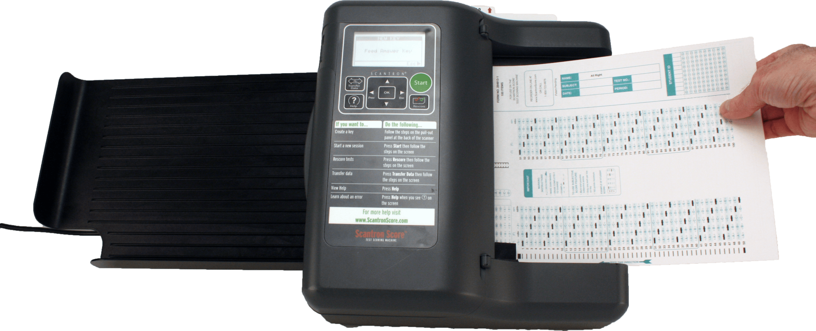
Scanners and Reading Devices (3 of 10)
An optical reader is a device that uses a light source to read characters, marks, and codes and then converts them into digital data that a computer can process
Optical Character Recognition (OCR)
Optical Mark Recognition (OMR)
e.g. scantron

Slide 43
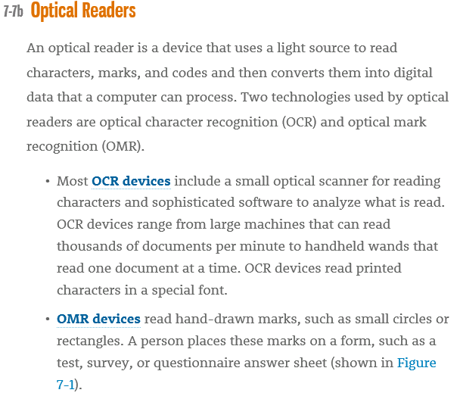

Slide 44
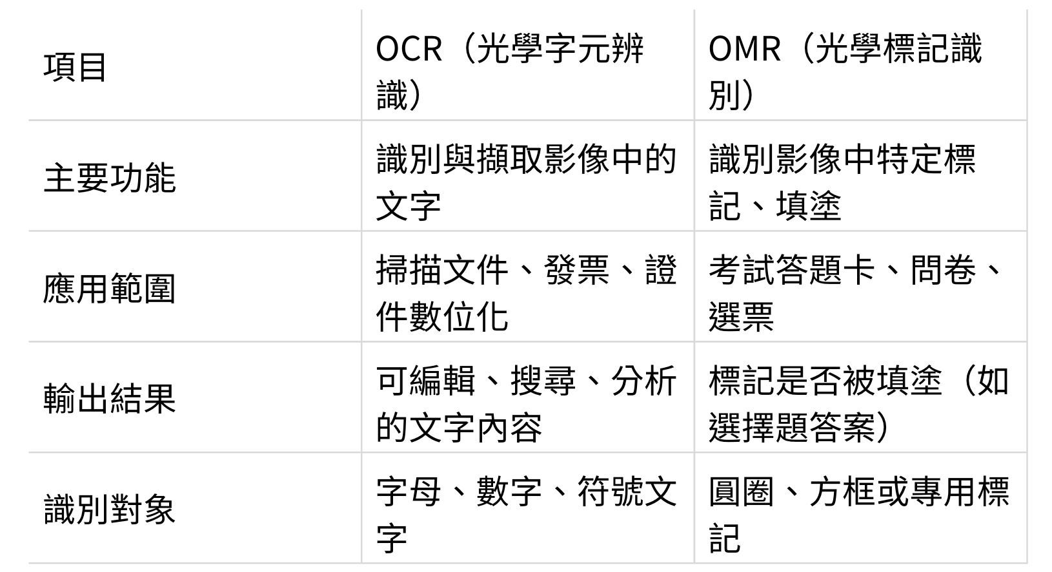
Scanners and Reading Devices (3 of 10)

Slide 45
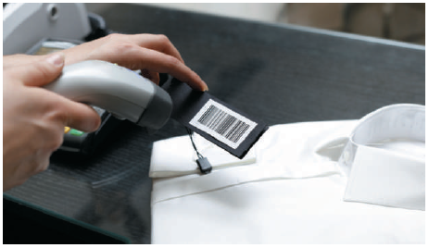
A bar code reader, also called a bar code scanner uses laser beams to read bar codes.
Figure 7-17 A bar code reader uses laser beams to read bar codes on products such as clothing, shown here.

Slide 46
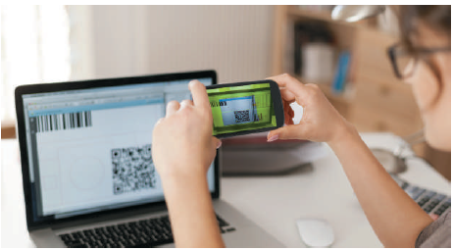
A Quick Response (QR) code stores information in both a vertical and horizontal direction.
Figure 7-18 This customer pays her bills by scanning an on-screen QR code.

Slide 47
Scanners and Reading Devices (6 of 10)
RFID (Radio Frequency IDentification) uses radio signals to communicate with a tag placed in or attached to an object
An RFID reader reads information on the tag via radio waves
RFID can track:
Tracking times of runners in a marathon
Tracking location of people and other items
Checking lift tickets of skiers
Gauging temperature and pressure of tires on a vehicle

Slide 48
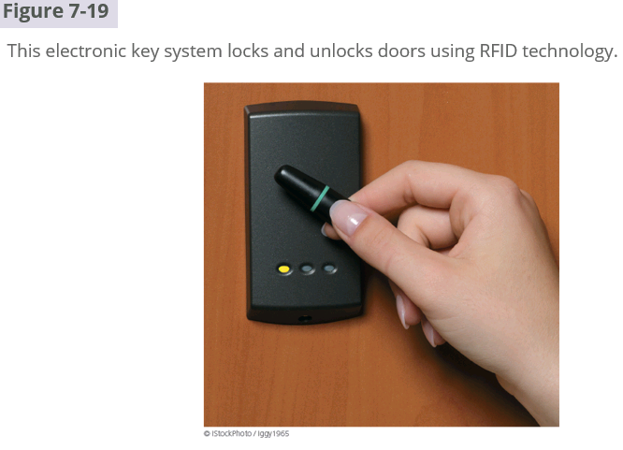
RFID: Radio Frequency IDentification

Slide 49
Scanners and Reading Devices (7 of 10)
Checking out library books
Managing purchases
Tracking payment as vehicles pass through booths on tollway systems
Magstripe readers read the magnetic stripe on the back of cards such as:
Credit cards
Entertainment cards
Bank cards
Identification cards
Other similar cards

Slide 50
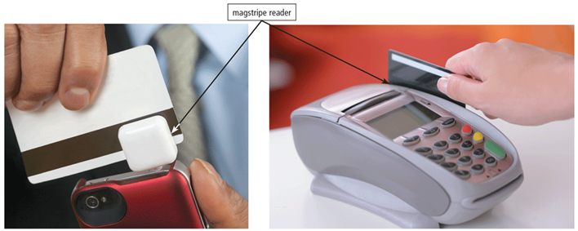
Figure 7-20 A magstripe reader reads information encoded on the stripe on the back of a credit card.

Slide 51
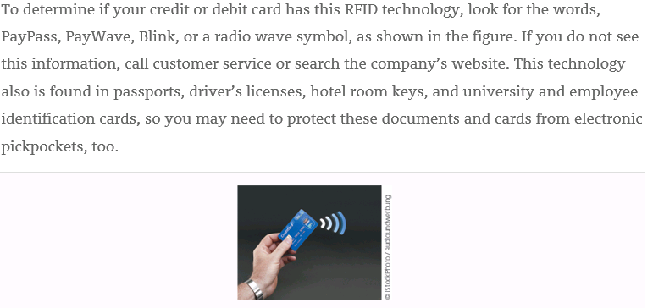
RFID: Radio Frequency IDentification

Slide 52
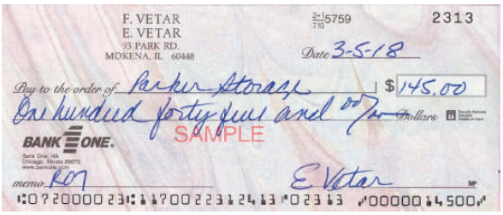
MICR (Magnetic Ink Character Recognition) devices read text printed with magnetized ink
An MICR reader converts MICR characters into a form the computer can process
Banking industry uses MICR for check processing
Figure 7-21 The MICR characters preprinted on the check represent the bank routing number, customer account number, and check number. The amount of the check in the lower-right corner is added after the check is cashed.

Slide 53
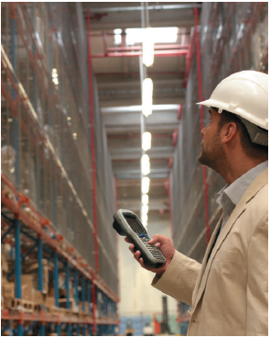
A data collection device obtains data directly at the location where the transaction or event takes place
Figure 7-22 An employee in a warehouse uses this data collection device to scan items, which wirelessly transmits information about the scanned item to the store’s inventory system.

Slide 54
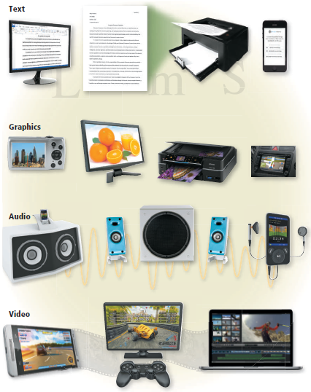
Output is data that has been processed into a useful form.
Figure 7-23 Four types of output are text, graphics, audio, and video.

Slide 55
哈哈哈
https://www.youtube.com/shorts/nTp-tBS90w8
https://www.youtube.com/watch?v=09mdNhQorck&t=2s

Slide 56
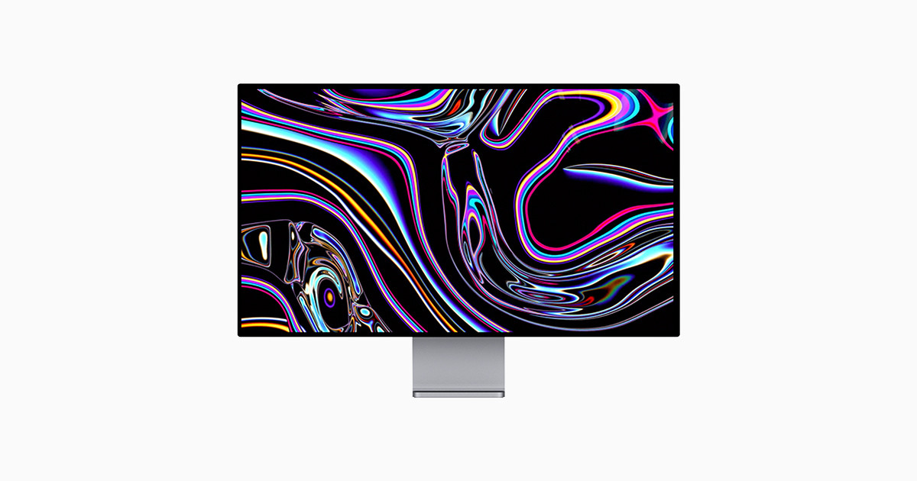
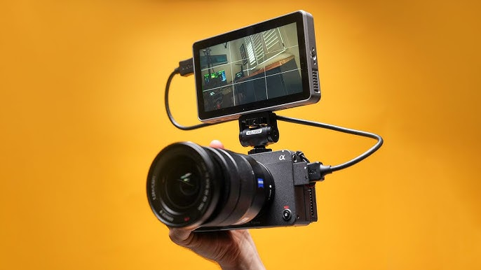
Displays (1 of 5)
A display visually conveys text, graphics, and video information.
A monitor is a display that is packaged as a separate peripheral device
Liquid Crystal Display (LCD) monitor

Slide 57
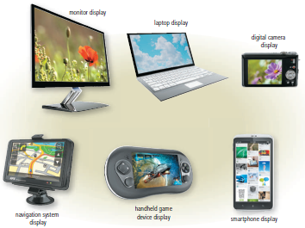
Figure 7-24 A variety of displays.

Slide 58
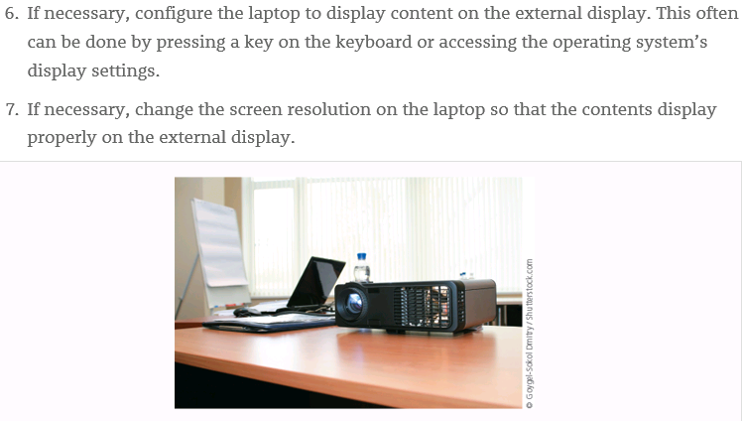

Slide 59

Displays (3 of 5)
The quality of a display depends primarily on its:
Resolution
Response time
Brightness
Dot pitch
Contrast ratio
Today’s monitors use a digital signal to produce a picture.
相關聯

Slide 60
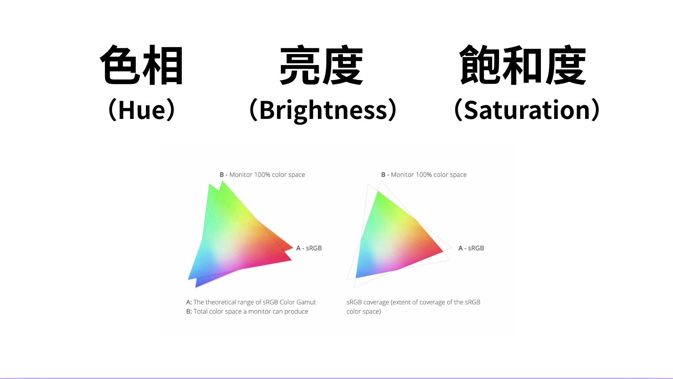
照片如何組成

Slide 61
Displays (4 of 5)
To display the highest quality images, the monitor should plug in a:
A Digital Visual Interface (DVI) port
An High-Definition Media Interface (HDMI) port
A Display Port
Home users sometimes use a Digital TeleVision (DTV) as a display
High-Definition TeleVision (HDTV) is the most advanced form of digital television
A Smart TV is an Internet-enabled HDTV

Slide 62
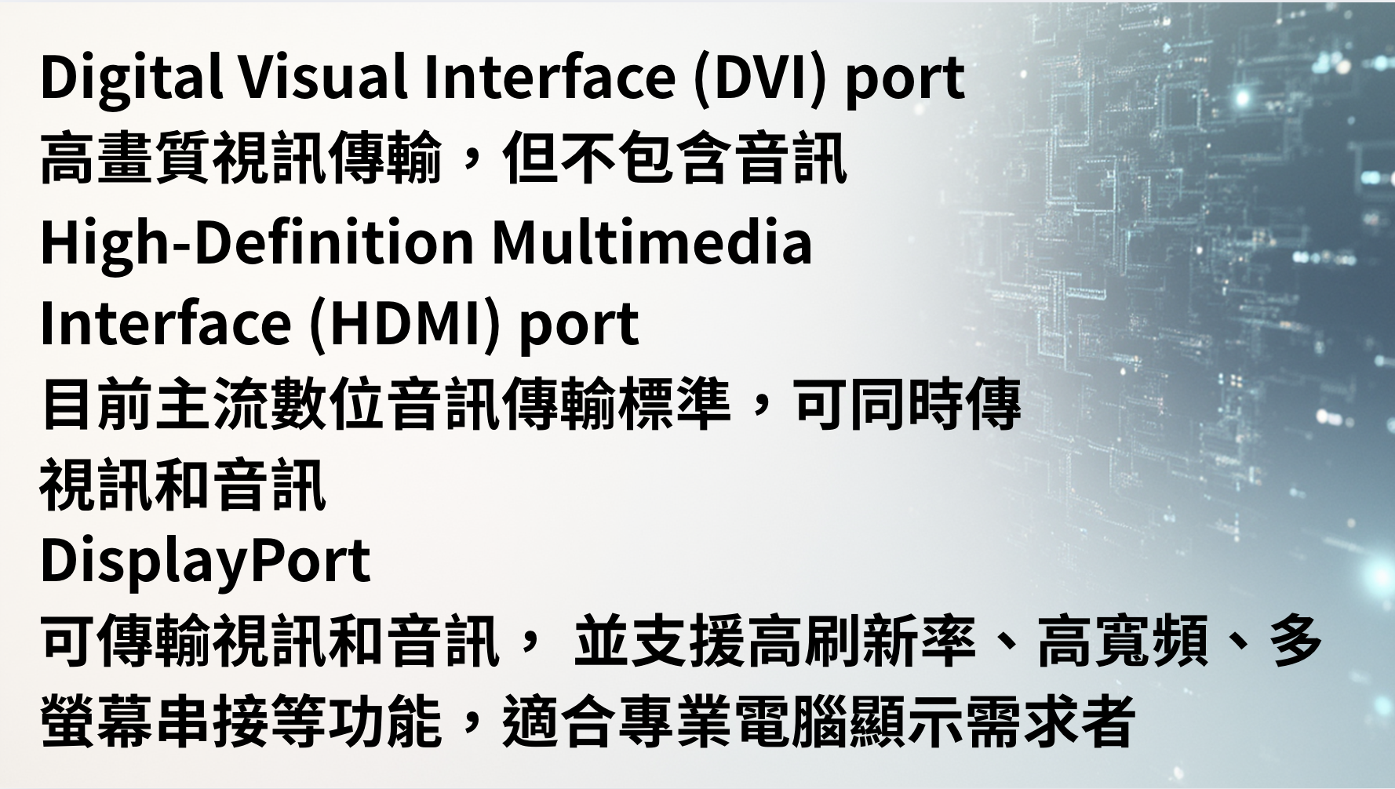

Slide 63
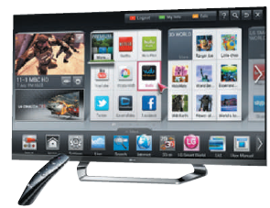
Figure 7-25 Smart TVs enable you to connect to the Internet and/or watch television shows.

Slide 64
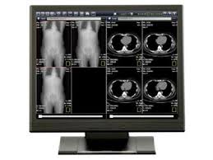
醫療顯示器
醫療顯示器（medical display）是一種專門設計用於醫療影像診斷和臨床應用的專業螢幕，具有高解析度、高亮度、高灰階和精確色彩等特點
能呈現更細緻的灰階層次（通常支援10-bit或12-bit灰階）
亮度高且穩定，對比度優良，能確保在任何光源或環境下正確顯示醫學影像

Slide 65

A printer is an output device that produces text and graphics on a physical medium.
Before purchasing a printer, ask yourself a series of questions:
Figure 7-26 Questions to consider before purchasing a printer.

Slide 66
Printers (2 of 13)
A nonimpact printer forms characters and graphics on a piece of paper without actually contacting the paper
Ink-jet printers
Photo printers
Laser printers
All-in-one printers
3-D printers
Thermal printers
Mobile printers
Label printers
Plotters
Large-format printers

Slide 67

An ink-jet printer forms characters and graphics by spraying tiny drops of liquid ink onto a piece of paper
Color or black-and-white
Speed is measured by the number of Pages Per Minute (PPM) it can print.
Figure 7-27 Ink-jet printers are a popular type of color printer used at home and in the office.

Slide 68


Slide 69

A photo printer is a color printer that produces lab-quality photos
Many use ink-jet technology
Figure 7-29 A photo printer.

Slide 70


Slide 71

Figure 7-29 A photo printer.

Slide 72


Slide 73

雷射印表機運作原理

Slide 74

An all-in-one printer is a single device that prints, scans, copies, and in some cases, faxes.
Also called a multifunction printer
Figure 7-32 An all-in-one printer.

Slide 75

A 3-D printer uses a process called additive manufacturing to create an object by adding material to a three-dimensional object, one horizontal layer at a time.
Figure 7-33 A 3-D printer creates a rib cage from the digital model.

Slide 76


Slide 77
哈哈哈
https://www.youtube.com/watch?v=NNhnXAmlViM
https://www.youtube.com/shorts/HM-IqXhQlT0

Slide 78

A thermal printer generates images by pushing electrically heated pins against the heat-sensitive paper
Dye-sublimation printer
Figure 7-34 A dye-sublimation printer.

Slide 79

A mobile printer is a small, lightweight, battery-powered printer that allows a mobile user to print from a mobile device.
Figure 7-35 A mobile printer is small enough to fit in a backpack.

Slide 80

A label printer is a small printer that prints on an adhesive-type material that can be placed on a variety of items.
Figure 7-36 A label printer.

Slide 81

Plotters are used to produce high-quality drawings.
Large-format printers create photo-realistic quality color prints.
Figure 7-37 Graphic artists use large-format printers to print signs, posters, and other professional quality displays.

Slide 82

Impact printers form characters and graphics on a piece of paper by striking a mechanism against an inked ribbon that physically contacts the paper
Figure 7-38 An impact printer produces printed images when tiny pins strike an inked ribbon.

Slide 83

Figure 7-45 A Braille printer.

Slide 84

Many users attach surround sound speakers or speaker systems to their computers, game consoles, and mobile devices to generate higher-quality sounds.
Figure 7-39 Users often attach high-quality surround sound speaker systems to their computers, game consoles, and mobile devices.

Slide 85

Headphones are speakers that cover or are placed outside of the ear.
Earbuds (also called earphones) rest inside the ear canal.
Figure 7-40 In a crowded environment where speakers are not practical, users can wear headphones to hear audio output.

Slide 86

A data projector is a device that projects the text and images displaying on a computer or mobile device screen on a larger screen so that an audience can see the image clearly
Figure 7-41 A data projector projects an image from a computer or mobile device screen on a larger screen so that an audience easily can see the image.

Slide 87

An interactive whiteboard is a touch-sensitive device, resembling a dry-erase board, that displays the image on a connected computer screen
Figure 7-42 Teachers and students can write directly on an interactive whiteboard, or they can write on a slate that communicates wirelessly with the whiteboard.

Slide 88

Joysticks, wheels, gamepads, and motion-sensing game controllers can be considered output devices when they include force feedback
Technology that sends resistance to the device in response to actions of the user
Figure 7-43 Gaming devices often use force feedback, giving the user a realistic experience.

Slide 89

Figure 7-44 A camera/receiver mounted on the monitor tracks the position of the head-mounted pointer, which is the reflective material on the brim of the hat. As the user moves her head, the pointer on the screen also moves.

Slide 90


Slide 91
Summary
Variety of options for input and output
Several assistive technology options for input and output

Slide 92
Questions
• Write down three type of input device
• What is the full form of RFID?
• How does 3-d printer work?

Slide 93
Answer
• keyboard, touch screen and digital pen
• Radio Frequency Identification
• adding material to a three-dimensional object, one horizontal layer at a time

Slide 94
Project due Dec. 5, 2022
Use scanner to scan the page with the same page number as your ID number.
Use Optical Character Recognition (OCR) software to convert image into text.
Use Microsoft Word to right-justify the text, make it bold, and print it on laser printer.

